Slide 1
CEJA Workforce Programs Overview

Slide 2
What is CEJA?
Review of the CEJA Programs
Centering Equity in the workforce Program
CEJA Workforce Programs
Key Roles and Partners
Partnering
Resources
Topics

Slide 3
What is the Climate and Equitable Jobs Act, or
CEJA?
Equitable workforce & business development
Support for fossil fuel communities and workers
Comprehensive energy legislation that centers equity and puts Illinois on track to achieve 100 percent renewable energy by 2050.
DCEO is responsible for administering workforce and business development programs.
Electric transportation
Energy access & solar for all
Carbon-free power
Renewable energy
Energy efficiency

Slide 4
The goal is 100% carbon-free power by 2050. Here’s where our electric grid is now.

Slide 5
CEJA Workforce & Business Development Ecosystem
Contractor support programs
Workforce training programs
Contractor Incubator Program
Primes Contractor Accelerator
Clean Jobs Workforce Network Program
Climate Works Pre- apprenticeship Program
Economic development, jobs & environmental justice
Energy Transition Navigator Program
Returning Resident Clean Jobs
Training Program
Energy Transition Community Grant
Equitable Energy Future Grant
FEJA
workforce programs
Coal to solar
Community Solar Energy Sovereignty

Slide 6
The CEJA Workforce Programs will prepare people for clean energy jobs.
Solar energy
Solar thermal
Wind energy
Electric vehicle
Green hydrogen
Energy efficiency
Healthy building materials
Energy storage
Industries achieving emission reductions
Clean energy jobs are those that manufacture, develop, build, install, maintain, or provide ancillary services in these industries. They provide administrative, sales, and other support functions in these industries.

Slide 7
CEJA Workforce Goals
Train Illinoisans for jobs in clean energy industry to capitalize on clean energy investments.
Spur adoption of renewable energy, energy efficiency, and electric vehicles in all Illinois communities.
Help clean energy businesses grow and all Illinois communities prosper.
Address inequities in access to clean energy jobs and economic opportunities.
Be a catalyst for the full inclusion of women, people of color, justice-involved people, and other underrepresented individuals in clean energy.

Slide 8
CEJA Workforce Programs Center EQUITY.
Some groups of people and communities benefit more from clean energy investments.
Some suffer more from environmental impacts and economic disinvestment.
The benefits of clean energy investments and good-paying clean energy jobs should be distributed equitably.

Slide 9
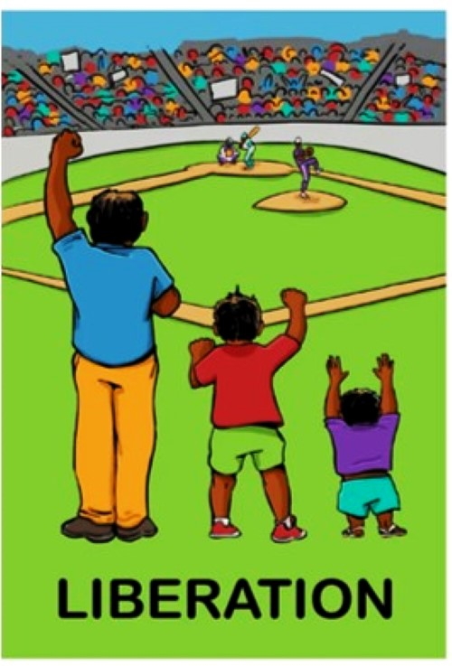
Equitable Workforce Development
Equality
Equity
Justice
Ensuring individuals from all ethnic and racial backgrounds have equal access to opportunities, resources, and support by addressing systemic barriers and fostering inclusive practices
Providing tailored resources and support to ensure that individuals from under-represented groups have fair opportunities to succeed
Fair and equitable treatment ensuring all inequities are addressed and rectified by creating policies and practices that combat discrimination and promotes an environment where everyone can succeed

Slide 10
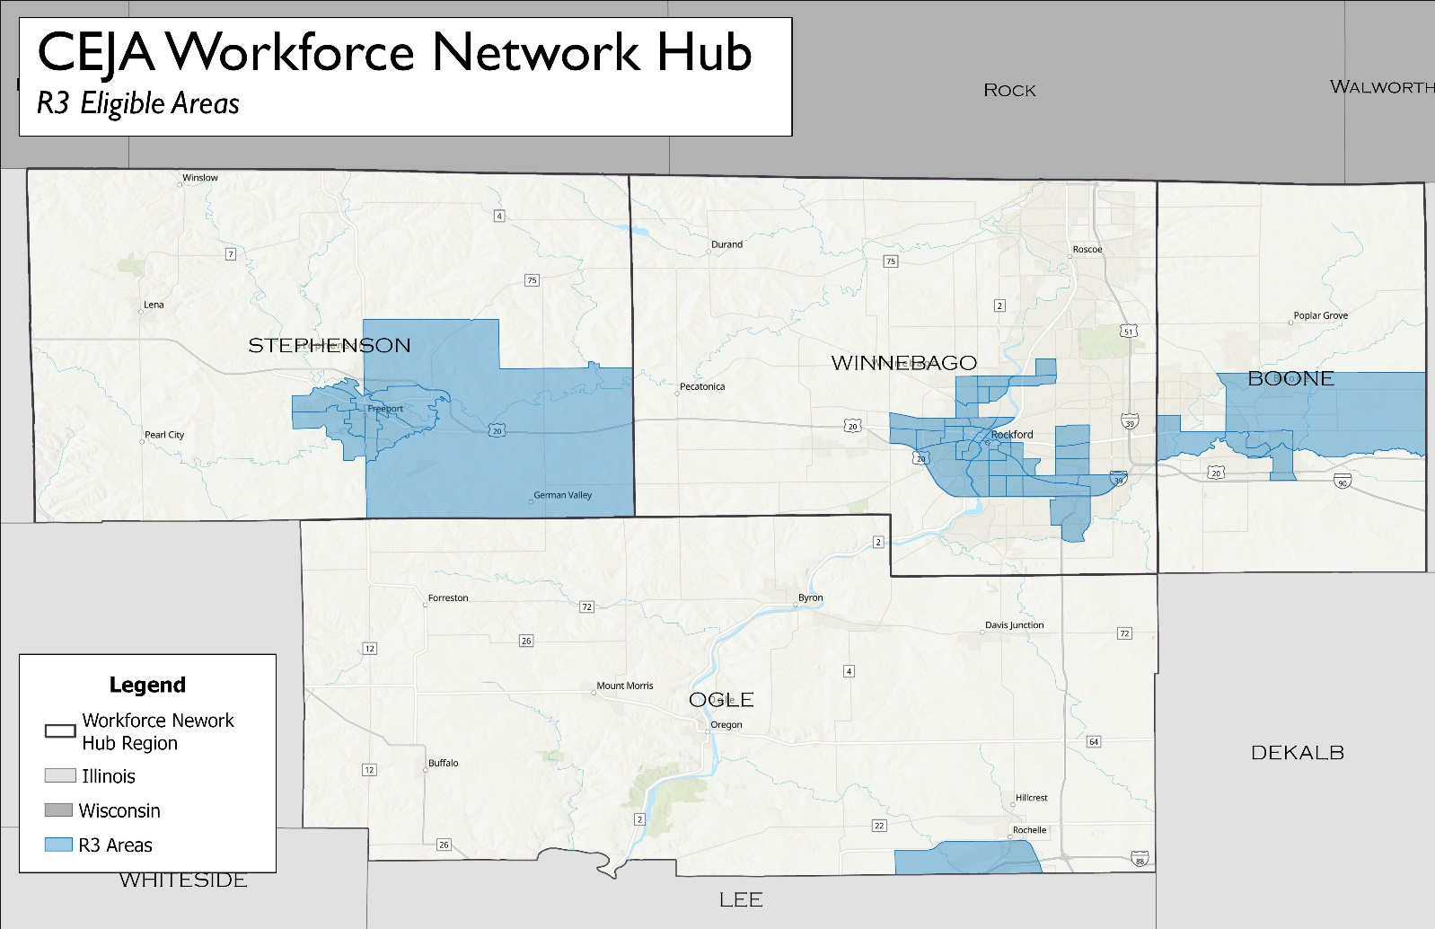
Who will programs serve?
Target populations:
People living in equity investment eligible communities (environmental justice or R3 communities)
Former members of foster care
Displaced energy workers People with barriers to employment (such as incarceration)
CEJA Grantee Map (arcgis.com)

Slide 11
Status of CEJA workforce programs
Program | Status
Climate Works Pre- apprenticeship | Goodwill has begun offering training, pre-grant award
Energy Transition Navigator Program | Will begin recruiting students in late Summer 2024
Clean Jobs Workforce Network Program (13 Hubs) | Will begin recruiting students in late Summer 2024
Contractor Incubator | Grant was just awarded, waiting on DCEO for next steps

Slide 12
CEJA Workforce Programs
Climate Works Pre-apprenticeship Program
Applicant: Goodwill Industries of Northern Illinois, Awaken Foundation L3C and Partners
Goal: Prepare people for registered apprenticeships and clean energy jobs in the Construction and Building Trades.
Three regional centers deliver pre-apprenticeship training.
Centers will provide basic construction training with a clean energy.
Funding for barrier reduction supports is included.
Areas served include Winnebago and DeKalb counties.
Climate Works Pre- apprenticeship Program

Slide 13
CEJA Workforce Programs
Energy Transition Navigators Program
Lead Applicant: Goodwill Industries of Northern IL
Partners: The Workforce Connection, Awaken Foundation L3C, Zion West Enterprises, Region 1 Planning Council, Rock Valley College
Recruit participants for CEJA workforce programs.
Conduct outreach & education to build awareness of CEJA programs.
Build connections with communities, employers, and stakeholders.
Energy Transition Navigator Program

Slide 14
CEJA Navigator Program
Key Actions and Outcomes: Share information about the Clean Energy industry and training and employment opportunities.
Map out CEJA Workforce Programs and recruit participants for programs.
Conduct outreach in equity eligible communities to ensure individuals are aware of opportunities and how to participate.
Build connections with communities, employers, and stakeholders.
Help individuals enroll and reduce barriers to enrollment.
Work hand-in-hand with Network Hub Program, Pre-Apprenticeship Program, and Incubator Program.
Key metrics include sharing opportunities with 500 people and helping network to enroll 150 people.

Slide 15
CEJA Workforce Programs
Clean Jobs Workforce Network Program (“Workforce Hubs”) Lead Applicant: The Workforce Connection Partners: Goodwill Industries of Northern Illinois, Awaken Foundation L3C, Zion West Enterprises, Region 1 Planning Council, Rock Valley College
Goal: Prepare people for entry-level clean energy jobs.
Clean jobs training will be available at 13 hub locations including hub in Rockford.
Training will utilize a standard clean jobs curriculum framework.
Funding for the Barrier Reduction Program will be included.
Clean Jobs Workforce Network Program

Slide 16
Awaken Foundation L3C
Awaken Foundation L3C was established in 2016 to provide pre-apprenticeships and full apprenticeships skills training to help decrease violence, generational poverty, and unemployment in some of the hardest hit areas in the Rockford community.
Awaken Foundation L3C prides itself on the quality training they provide. We have certified trainers with years of experience in the industry who work with our trainees both in a classroom setting and job site training. Our credentials include
OSHA 30,
First Aid/CPR,
Carpentry, landscaping, and more
Pre-apprenticeship and full apprenticeship participants are trained and qualified to have opportunities in trades unions, non-trades construction companies, and even have opportunities to grow their own companies and services within the industry.

Slide 17
Zion West Training
Mission:
To provide Ellis Heights youth and adults a holistic approach to help youth and adults disproportionately affected by poverty and violence build a better future.
Since its founding, Zion West has shifted from just a service organization to one that also convenes partners together in support of its priority areas of safety, education, economic development, and family well-being.
Training provide will be Solar Photovoltaic Training, which will prepare individuals for jobs in solar.

Slide 18
History: Established in 1965, Rock Valley College (RVC) has been a cornerstone of higher education in the Rockford, Illinois region, dedicated to providing quality education and fostering lifelong learning.
Community and Industry Partnerships: RVC has strong connections with regional businesses and industries, collaborating on workforce development initiatives to meet the evolving needs of the community and support economic growth in Career & Technology Training (CTE).
Overview of training provided (Types of jobs students will be ready for)
Automotive Technology (Electric/Hybrid Vehicle Safety & Maintenance)​
Clean Manufacturing Technology (CNC Machining and 3D Printing)​

Slide 19
CEJA Contractor Programs
Contractor Incubator Program Lead Applicant: The Workforce Connection Partners: Think Big!, Rock Valley College, Region 1 Planning Council
Goal: Help businesses grow and build capacity to do clean energy projects
Provide access funds, services, and support to contractor businesses
Business supports will be available at 13 hub locations, including Rockford
Contractor Incubator Program

Slide 20
Think Big! is the leading resource for minority owned businesses. We are committed to removing barriers that prevent the minority community from business growth and development. As barriers are removed, existing and aspiring entrepreneurs will be inspired and encouraged to Think Big!
Classes include:
Formalizing Your Business: Side Hustle to Legit
Business Credit: It Takes Money to Make Money
Branding and Marketing: Seeing is Believing
Developing Your Business Plan: Started from the Bottom, NOW You’re HERE!
Clean Renewable Energy Strategies for a Sustainable Future
In addition to classes, Think Big! Provides business coaching and mentoring.

Slide 21
Region 1 Planning Council
R1 became a regional planning commission in 2017, though its transportation planning origins date back to 1941
R1 provides government-to-government services, including transportation, land-use, sustainability and economic development planning, grant writing, data analytics, GIS and economic modeling, and operation of a 5-county land bank
The R1Energy Stakeholder Committee provides coordination for CEJA grant programs and two US Department of Energy grants providing new electric grid technology and resiliency in Northern Illinois

Slide 22
Barrier Reduction Supports throughout
Through all programs, Barrier reduction support is provided.
This includes:
Stipends for training
Transportation support
Assistance removing barriers, including housing, health,
benefits, and more
Equipment and tools
Support, guidance, and encouragement

Slide 23
CEJA Workforce Programs
Illinois is investing in renewable energy, electric vehicles, and energy efficiency.
We need to expand the clean energy workforce to do the work.
Workforce training programs, focused on training equity investment eligible individuals
Clean energy employers select or hire apprentices or entry-level workers
Clean Jobs Workforce Network Program
Climate Works Pre- apprenticeship Program
Job or apprenticeship placement
Energy Transition Barrier Reduction Program
Returning Resident Clean Jobs
Training Program
Energy Transition Navigator Program
They work on clean energy projects funded by CEJA and more

