Slide 1
Title
subtitle
Renewable Energy Incentive Programs in Illinois
Kelly A. Turner
Chief Legal Counsel
Illinois Power Agency

Slide 2
Agenda
Introduction to the IPA and Solar Programs
Illinois Shines
Illinois Solar for All
Benefits to Participation
Becoming an Approved Vendor
Prevailing Wage and other labor requirements
Equity Requirements
Energy Workforce Equity Portal
Q&A

Slide 3
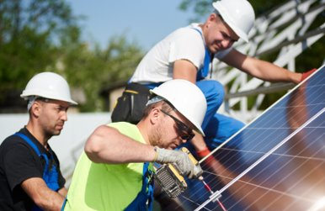
The Illinois Power Agency
Independent state agency created in 2007
Agency duties include:
Implementation of the state’s Renewable Portfolio Standard (RPS)
Conduct competitive procurements of RECs from utility-scale projects
Manage incentive programs for community solar and rooftop solar
Procure RECs from solar coupled with storage at former coal sites within Illinois
Other programs to incentivize carbon-free energy

Slide 4
Renewable Energy Credits (RECs)
A Renewable Energy Credit (REC) represents the environmental benefits of 1 MWh of electricity generated from a renewable energy generator
RECs are unique and created at the time of electricity generation
A REC is “retired” to prevent another party from claiming the environmental attributes associated with its generation
Businesses and organizations may also buy or sell RECs to meet internal goals
RECs retired through IPA programs are counted towards the achievement State’s goals for the Renewable Portfolio Standard (RPS)
$/REC
RECs
OR
MWh
$/MWh

Slide 5
IPA Programs and Procurements
Illinois Shines
Solar projects for mostly private residents and businesses
Illinois Solar for All (ILSFA)
Solar projects for income-eligible private residents and non-profit or public entities that serve income-eligible or environmental justice communities
Utility-scale Wind and Solar
Large solar or wind projects that sell energy into the wholesale markets
Brownfield
Large solar projects located on “brownfield” sites, as defined by statute
Self-Direct Program
Large industrial customers can privately retire RECs through long-term energy contracts and receive a credit on their electricity bill

Slide 6
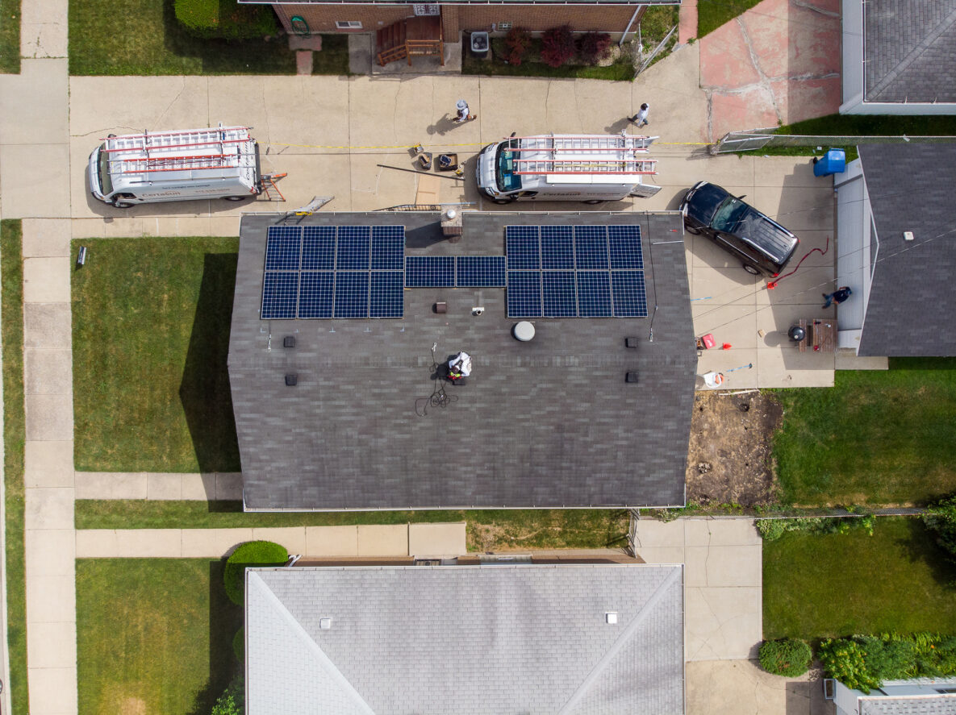
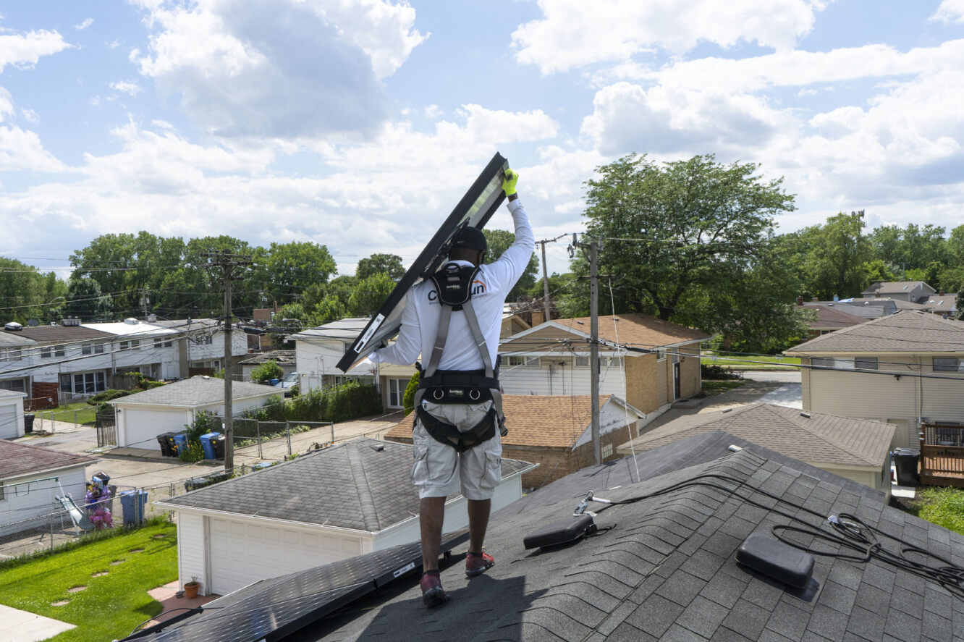
How can you participate?
As a public institution
Install onsite solar at public buildings/sites
Host or subscribe to a community solar project
Promote opportunities to save through solar to constituents
As a business
Host a project or subscribe to community solar
Do business in the solar market as a:
Approved Vendor – submit project applications to IPA programs and manage the project REC contract
Designee – play a customer-facing role in project development
Subcontractor – play a non-customer-facing role in project development under an Approved Vendor

Slide 7
Title
subtitle
Illinois Shines

Slide 8
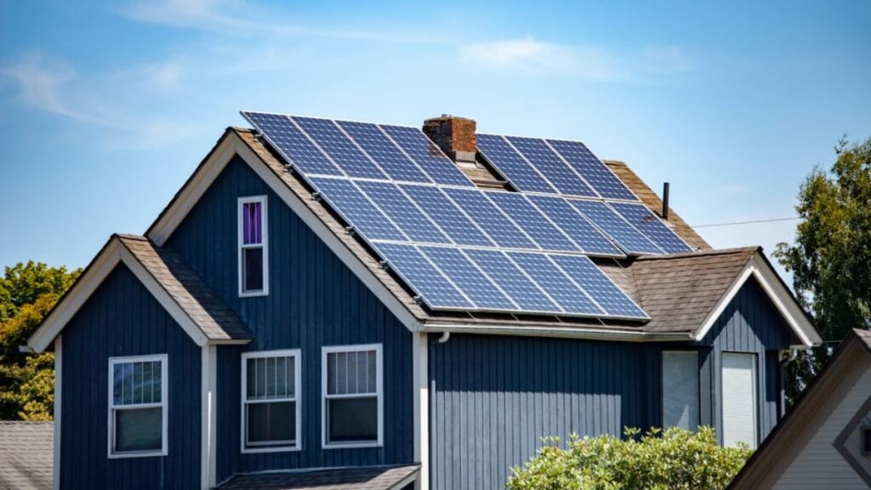
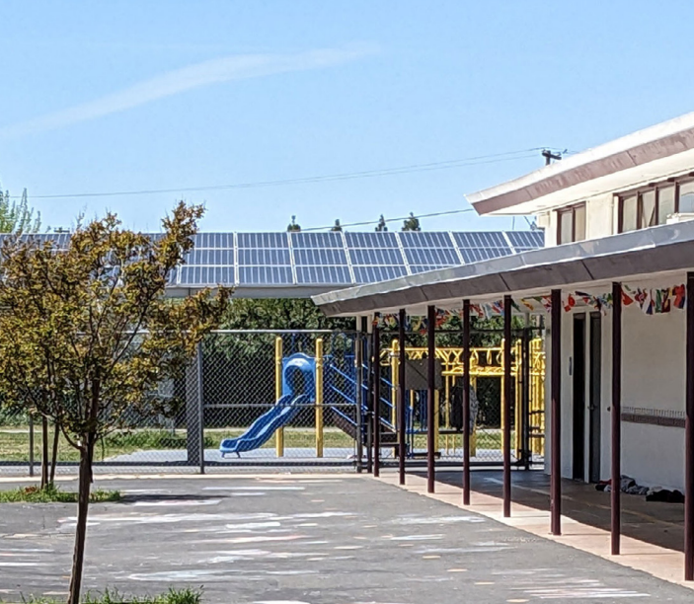
Illinois Shines Project Categories
Small Distributed Generation (DG) (20%)
Projects up to 25 kW in size, such as systems on a residence, small business, or other structures with a smaller energy load
Large Distributed Generation (20%)
Projects 25 kW to 5 MW in size, such as larger businesses, schools, factories, and other buildings with a larger energy load
Traditional Community Solar (30%)
Community solar projects 5 MW in size or below
Community-Driven Community Solar (5%)
Community solar projects up to 5 MW that provide a more direct and tangible connection and benefits to the communities in which they operate
Public entities can participate as hosts, anchor tenants, or subscribers
Public Schools (15%)
Located at public schools (including school district land), includes DG and CS
Equity Eligible Contractor (EEC) (10%)
Projects developed by Equity Eligible Contractors, includes DG and CS

Slide 9
Illinois Shines: Participate as a Customer
Who is eligible to participate?
All Illinois residents
Commercial and industrial customers
Public schools
Residential, commercial, and industrial customers can participate by:
Installing solar panels directly on roofs or on their property through the Distributed Generation (DG) category
• As subscribers in a community solar project through the Community Solar (CS) categories
Public Schools can participate by:
Installing on-site distributed generation projects to offset a school’s load either in the Public Schools or distributed generation categories
Through the Public Schools category as a community solar project anchor tenant and host

Slide 10
Illinois Shines: 2024-25 Program Year Capacity
Category | Allocation | Group A (MW) | Group B (MW) | Statewide
Small Distributed Generation | 18% | -- | -- | 142
Large Distributed Generation | 18% | -- | -- | 142
Traditional Community Solar | 27% | 64 | 149 | --
Community-Driven Community Solar | 4% | 11 | 25
Public Schools | 13% | -- | -- | 107
Equity Eligible Contractor | 20% | 48 | 112 | --

Slide 11
Illinois Shines: 2024-25 REC Prices
Distributed Generation |  |  |  | Community-Driven Community Solar
 | Group A | Group B |  |  | Group A | Group B
0 - 10 kW | $73.71 | $83.87 |  | 0 - 25 kW | $73.82 | $91.47
10 - 25 kW | $63.53 | $77.53 |  | 25 - 100 kW | $75.40 | $92.92
25 - 100 kW | $55.89 | $70.23 |  | 100 - 200 kW | $73.28 | $89.36
100 - 200 kW | $53.63 | $63.34 |  | 200 - 500 kW | $67.73 | $82.24
200 - 500 kW | $46.58 | $54.60 |  | 500 - 2000 kW | $57.93 | $68.95
500 - 2000 kW | $43.77 | $49.49 |  | 2000- 5000 kW | $41.94 | $49.79
2000- 5000 kW | $33.03 | $37.05
Traditional Community Solar |  |  |  | Public Schools
 | Group A | Group B |  |  | Group A | Group B
0 - 25 kW | $57.49 | $70.91 |  | 0 - 25 kW | $77.17 | $93.17
25 - 100 kW | $58.84 | $72.15 |  | 25 - 100 kW | $68.57 | $84.96
100 - 200 kW | $57.50 | $69.58 |  | 100 - 200 kW | $65.81 | $76.91
200 - 500 kW | $53.46 | $64.20 |  | 200 - 500 kW | $57.72 | $66.88
500 - 2000 kW | $46.02 | $54.24 |  | 500 - 2000 kW | $54.51 | $61.04
2000- 5000 kW | $33.99 | $39.98 |  | 2000- 5000 kW | $42.15 | $46.74

Slide 12
Title
subtitle
Illinois Solar for All

Slide 13
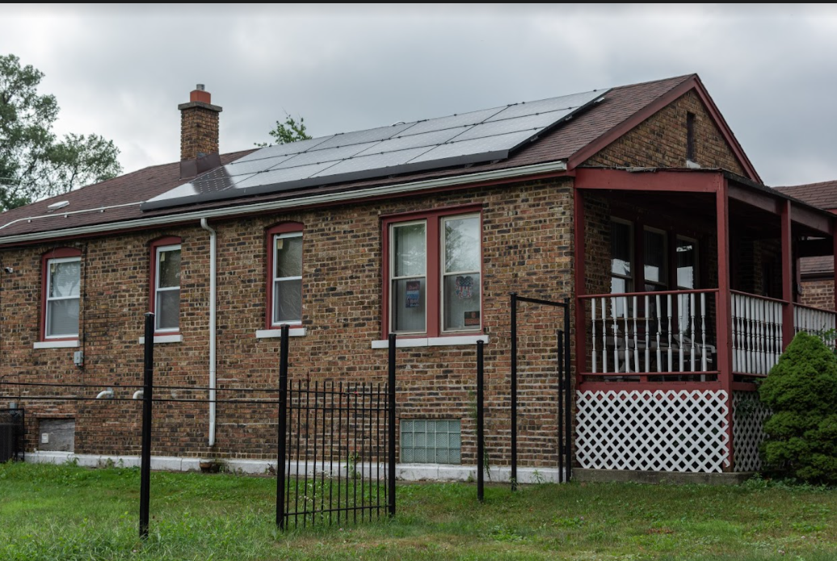
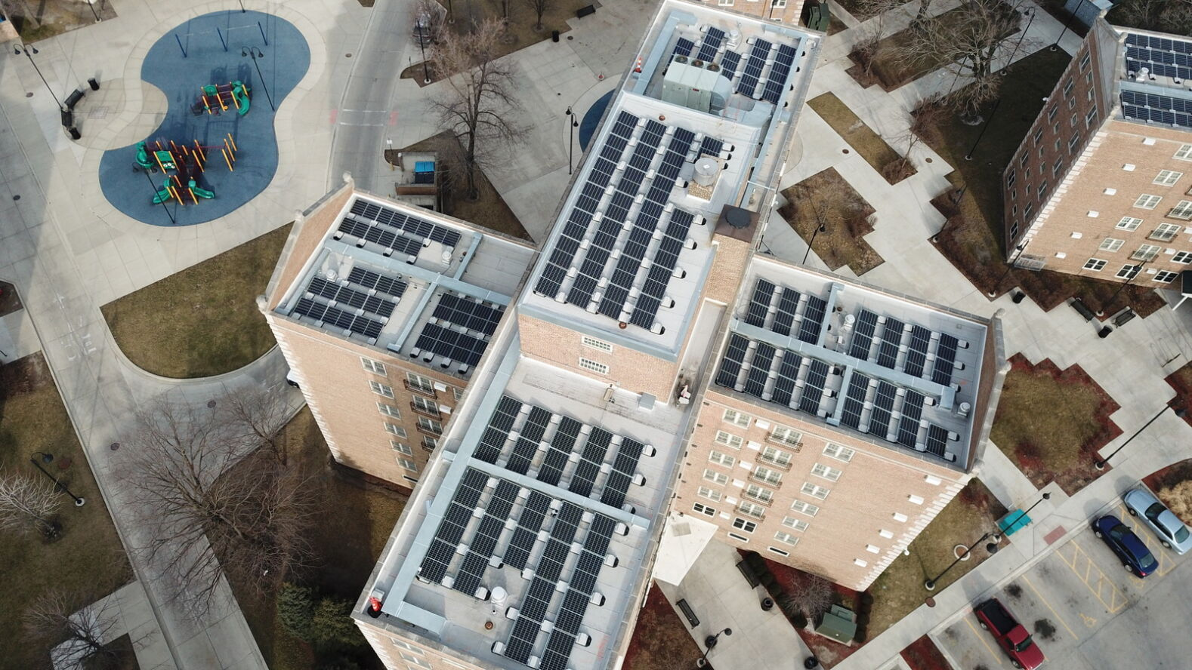
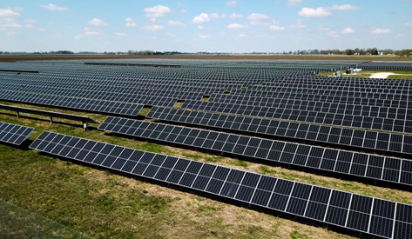
Illinois Solar for All (ILSFA)
Residential Solar Small​
Gives income-eligible households access to residential solar installations with no upfront costs and guaranteed savings for single-households or 1–4-unit buildings
Residential Solar Large​
Supports residential solar installations with no upfront costs and guaranteed savings for income-eligible households in larger buildings with 5 or more units
Non-Profits and Public Facilities​
Provides incentives for solar installations with no or low upfront costs on properties occupied by eligible non-profit organizations and public facilities that provide energy benefits directly to them
Community Solar ​
Offers income-eligible households' access to solar energy through subscriptions with guaranteed savings, without installation of solar panels on property

Slide 14
Illinois Solar for All (ILSFA)
Eligibility
Residents (Residential and Community Solar): 80% AMI
Non-profits/Public Facilities: Critical Service Provider and serves environmental justice or income-eligible communities
Job trainee requirements
Project level
Portfolio level
Customer must receive at least 50% of value generated by system

Slide 15
Illinois Solar for All: Customer Participation
Who is eligible to participate?
Income-eligible households (renters and homeowners)
Nonprofit organizations and public entities serving environmental justice communities or income-eligible communities
Income-eligible homeowners can participate:
By installing solar panels directly on their roof or mounting panels on their property through the Residential Solar sub-programs
As a subscriber in an ILSFA community solar project
Income-eligible renters can participate:
As a subscriber in an ILSFA community solar project
Nonprofit organizations and public entities can participate:
By installing on-site solar projects through the Non-Profit and Public Facilities sub-program
As subscribers in ILSFA community solar projects

Slide 16
Title
subtitle
Benefits of Participation

Slide 17
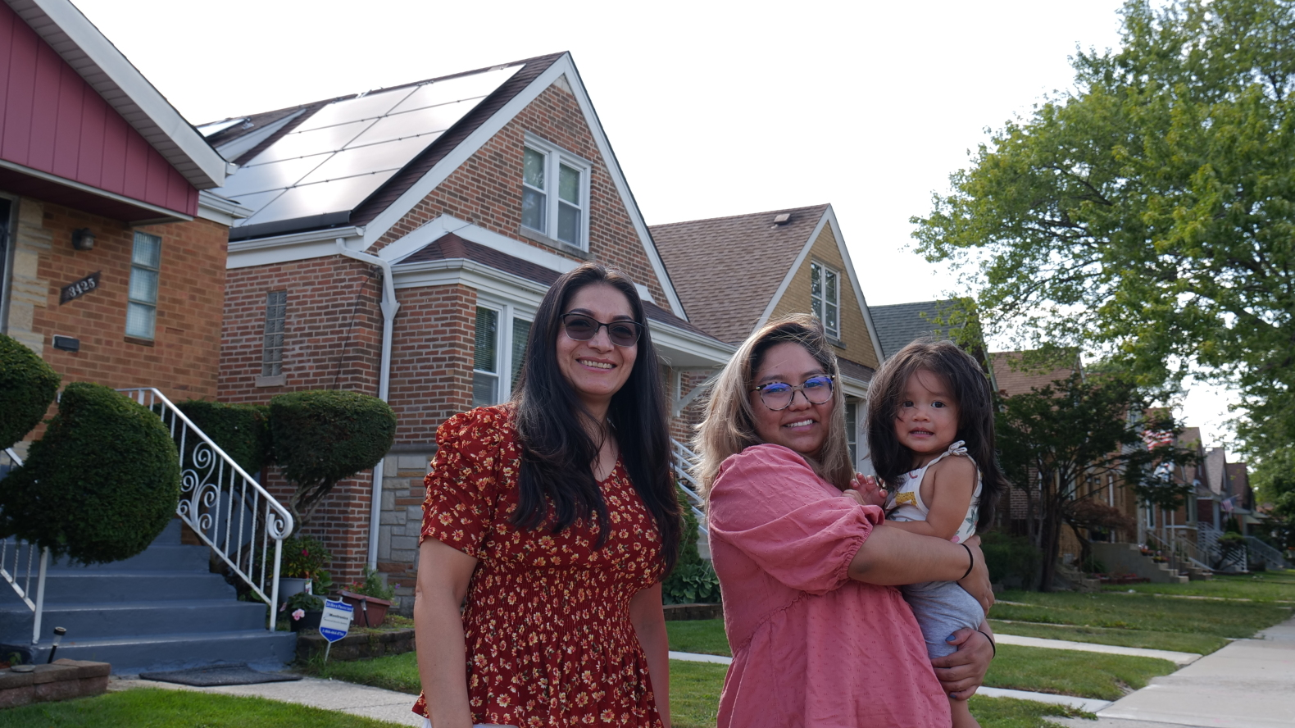
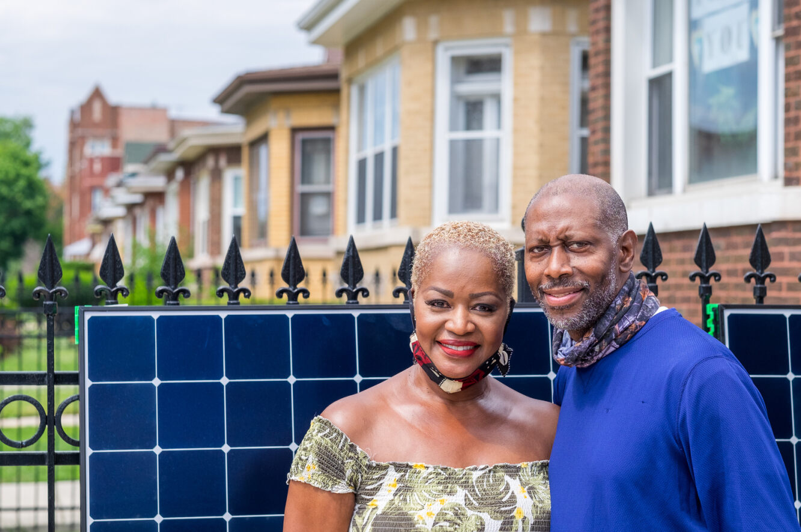
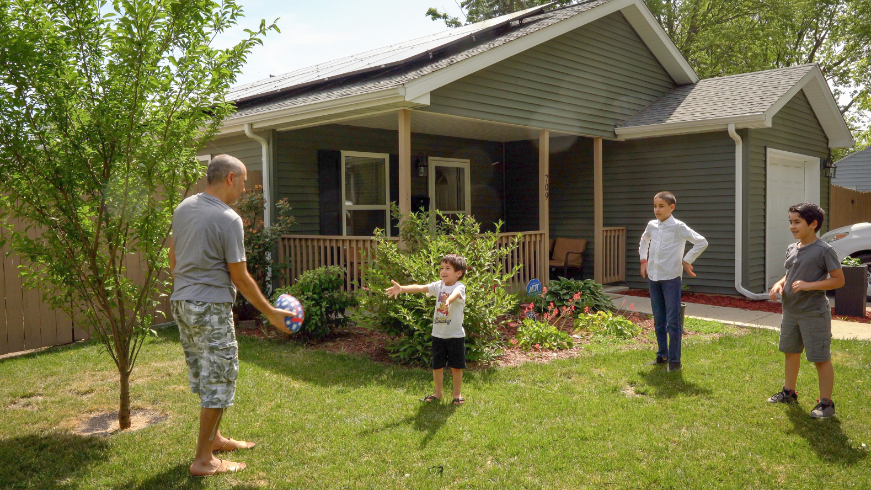
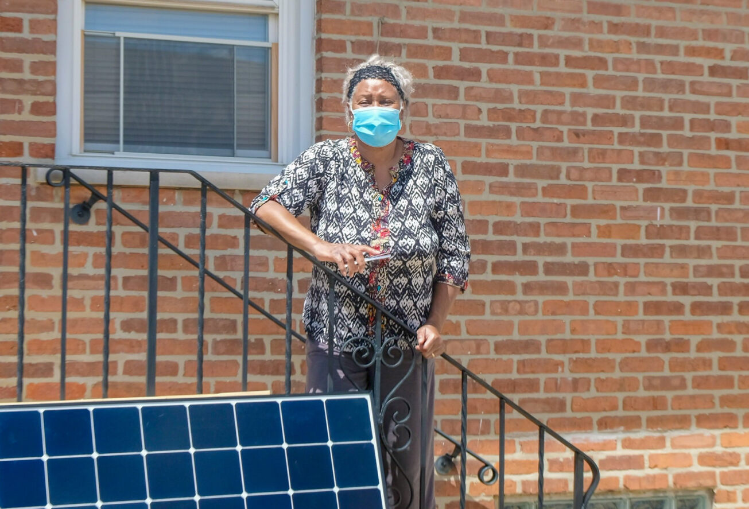
Benefits of Participation
Why should someone participate?
Save money on your electricity bill
For both DG and CS customers
Built in Consumer Protections
Standard Disclosures
Ability to cancel without penalty, varies by category/sub-program
Program sets out requirements for what information and terms must be included in your installation contract
Dedicated Program Administrator staff answer questions and assist in resolving customer complaints

Slide 18
Title
subtitle
Becoming an Approved Vendor in Illinois Shines and Illinois Solar for All

Slide 19
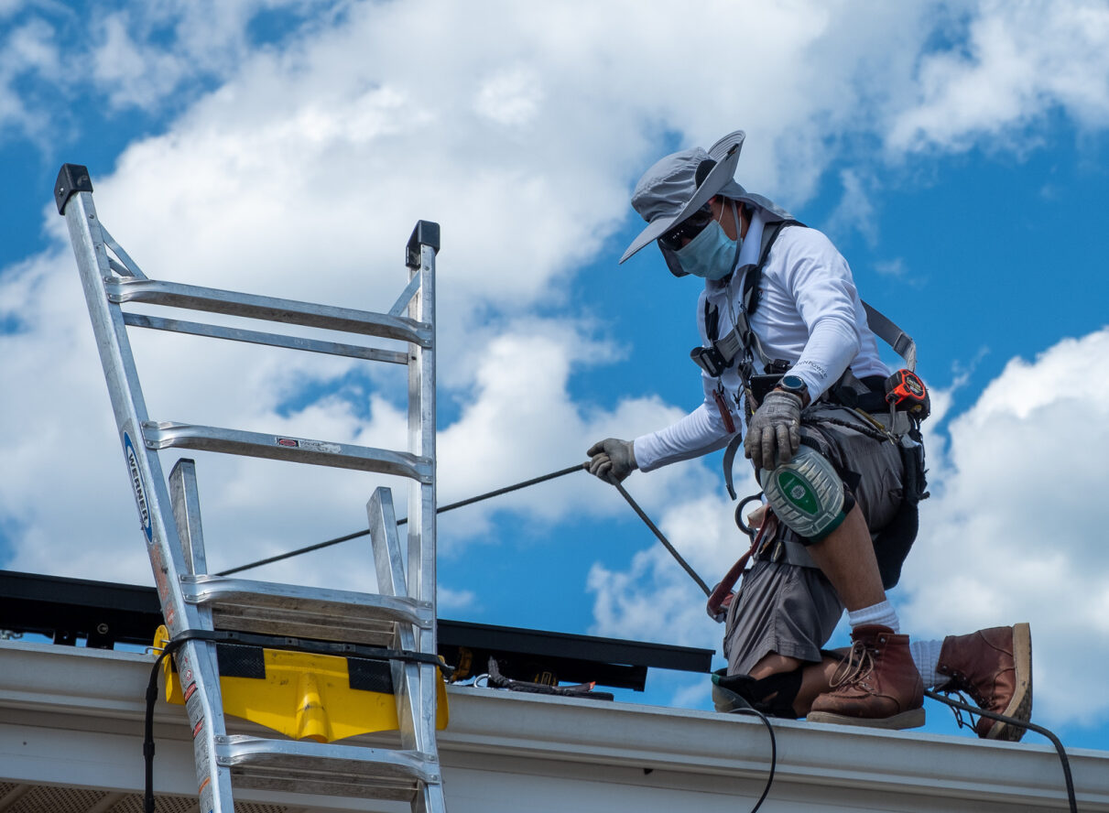
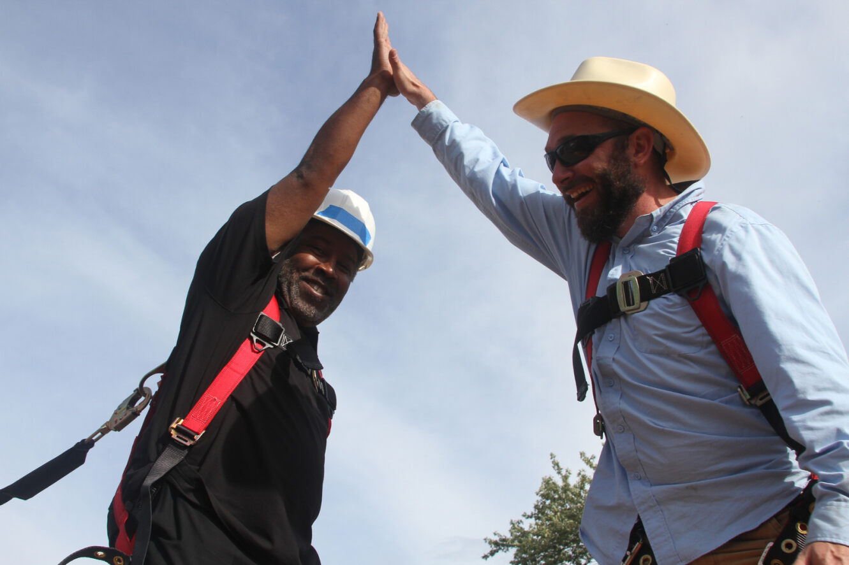
Approved Vendor Types
Approved Vendor
Complete and submit project application
Execute REC delivery contract
Comply with reporting, MES, labor, and other program requirements
Designee
Equity Eligible Contractor
An AV that is majority-owned by someone that qualifies as:
Formerly incarcerated
Former foster care participant
Participant or graduate of certain job-training programs
Resident of equity investment eligible community
Single Project Approved Vendor
MWBE Certification

Slide 20
Small & Emerging Business Guide
Guide Includes:
Steps to Certifications
Overview of Illinois Shines and ILSFA program policies
How to register as an Approved Vendor in Illinois Shines and ILSFA
Contact information for team members in each Program

Slide 21
Becoming an Approved Vendor
Learn more or get started!

Slide 22
Title
subtitle
Labor Requirements for Projects
Developed under IPA Programs & Procurements

Slide 23
Prevailing Wage Requirements
PWA requirements apply to most projects receiving state-administered funding through a REC contract
Utility-scale wind or solar projects
Brownfield site projects
Projects receiving incentives through Illinois Shines and ILSFA
Except for:
Residential projects
Projects sited at a house of worship and less than 100 kW
Large DG projects on the waitlist as of December 14, 2021
Projects participating in self-direct program

Slide 24
Prevailing Wage
Compliance
Check attestation in project application
Submit Certified Transcript of Payroll (CTP) to IL Dept of Labor (IDOL) and IPA
CTPs available on IDOL public database
Applies to construction, maintenance, and repairs
Applies to AVs, contractors, and subcontractors
For utility-scale projects:
Out-of-state projects must comply with local Prevailing Wage or Davis-Bacon wage rates if state does not have Prevailing Wage law, and must submit CTPs
Commitment to Prevailing Wage occurs with bid

Slide 25
Project Labor Agreements
Project labor agreement: a pre-hire collective bargaining agreement that covers all terms and conditions of employment on a specific construction project
Required for utility-scale, brownfield site, self-direct program
Not required for Illinois Shines and Illinois Solar for All
PLA must include goals for "apprenticeship hours to be performed by minorities and women"
Must include planned strategy for meeting those goals

Slide 26
Title
subtitle
IPA Equity Goals

Slide 27
Equity Goals and Requirements
Equity Accountability System framework
Minimum Equity Standard
Certain percentage of workforces must be 'Equity Eligible Persons' (10% currently)
Includes Equity Eligible Contractors
Percentages increase to 30% by 2030
EEC Category in Illinois Shines
Increases to 40% of program
Data Collection
IPA Efforts to Increase Equity
Energy Workforce Equity Portal
Upcoming Racial Disparity Study
Outreach to community orgs, unions, and employers

Slide 28
Energy Workforce Equity Portal (Portal)
Accessible, online tool that connects clean energy companies participating in Illinois Shines and utility-scale REC procurements with Equity Eligible Persons.
The portal is designed to:
Connect clean energy companies with Equity Eligible job seekers
Help individuals find out whether they qualify as Equity Eligible Persons, connect with prospective employers, and find jobs.
Allow clean energy companies to post jobs and verify EEP status of current employees
Help Equity Eligible Persons find information on workforce training programs and more

Slide 29
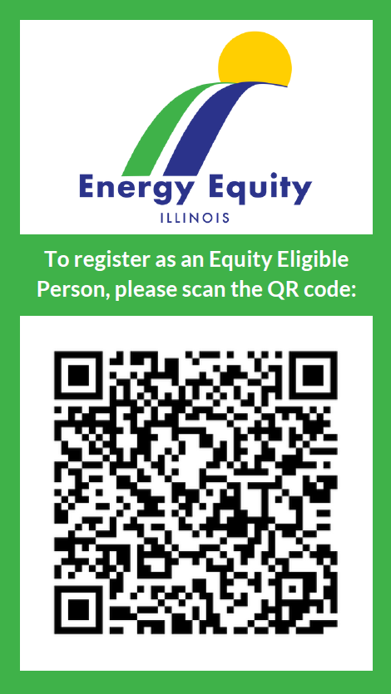
Energy Workforce Equity Portal (Portal)
,
Explore the Portal and learn more by visiting
energyequity.illinois.gov or:
For questions on equity portal, please email IPA.EnergyEquity@illinois.gov
For questions on Equity Eligible Contractor, please email Illinois Shines Program Administrator at eec@illinoisshines.com

Slide 30
Contact Info
Kelly A. Turner
Chief Legal Counsel
Kelly.A.Turner@Illinois.gov

