Slide 1
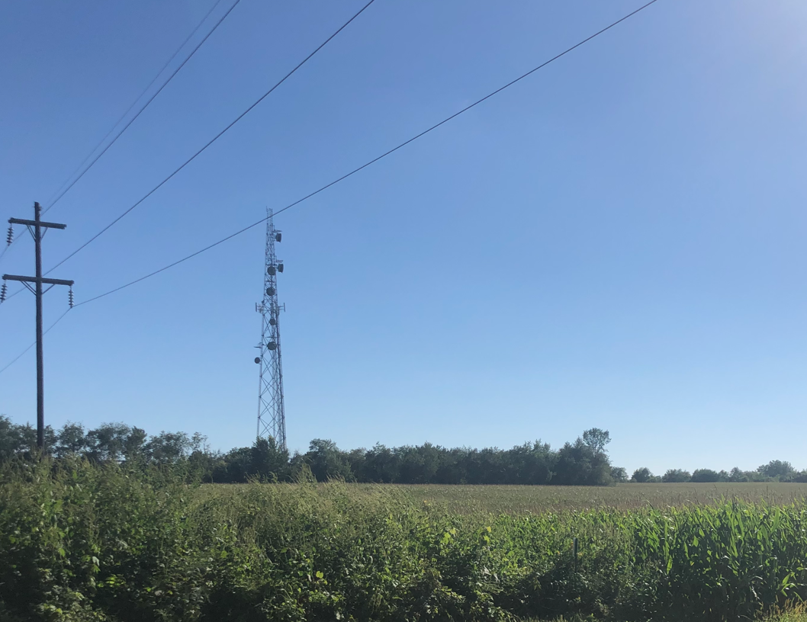
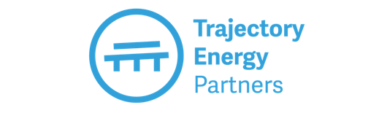
Subscribing to Community Solar
July 2024

Slide 2

llinois Renewable Energy Laws
Over the past two decades, the Illinois General Assembly has passed several laws to encourage and support renewable energy.
These laws bring the benefits of a clean energy economy to residents and businesses across Illinois, and will expand access to the savings, clean energy, and job benefits of solar power. Types of solar supported by these laws include:
CEJA
Behind the Meter
Community Solar
Utility Scale Solar
A home, business, or organization can install solar on their roof or on their land to directly power their home or building.
Provide utility savings for homeowners and businesses that can’t install solar on their roof by subscribing to a community solar project.
Large solar systems covering hundreds of acres of land that are directly connected to higher voltage utility lines and typically serve a single customer.
2

Slide 3
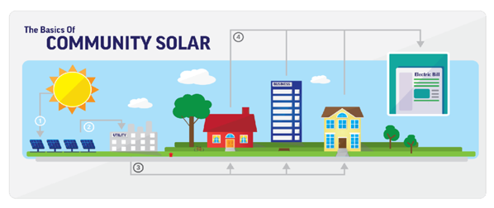
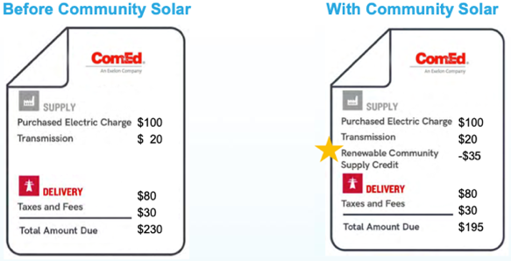
Community Solar
Community solar provides access to solar to residents, non-profits, communities, and public sector entities that can’t install solar on their roof or property. They can participate in a community solar project and receive credits on their utility bill for the energy produced by their share of the project.
3

Slide 4
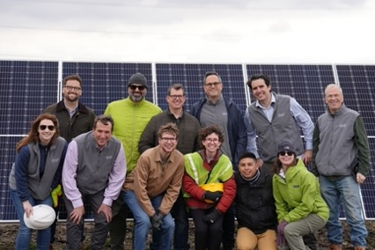
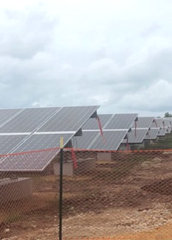
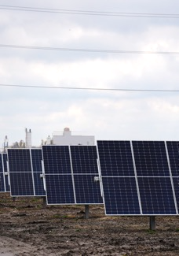
Trajectory and Its Projects
Trajectory Energy Partners is an Illinois-based company that brings together landowners, electricity users, and communities to develop solar energy projects with strong local support.
Rockford Solar
Gar Creek Solar
Trajectory developed the Rockford Solar project with the City of Rockford which owns the property, the Rockford Housing Authority, and a group of local organizations that supported the project.
Gar Creek Solar in Kankakee is located in a low-income and environmental justice neighborhood. The project will bring solar savings to low-income customers.
4
Notes:
Good

Slide 5
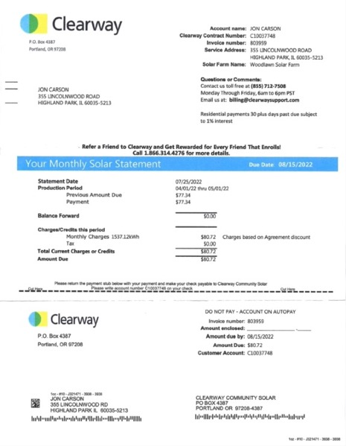
Community Solar Subscription
      ComEd Bill
      Community Solar Bill
5

Slide 6

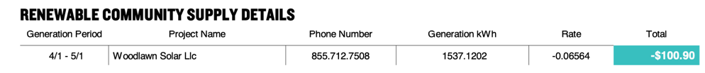
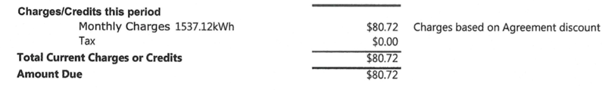
Community Solar Savings
      Credit on ComEd Bill: $100.90
      Discount rate: 20%
      Charge for credits: $80.72
      Total Savings for month: $20.18
6

Slide 7
Trustworthy Resources
Citizens Utility Board (nonprofit): https://www.citizensutilityboard.org/solar-in-the-community/
Illinois Power Agency (government):
Illinois Shines - https://illinoisshines.com/
Illinois Solar For All -
https://www.illinoissfa.com/programs/community-solar/
When you feel you have prepared enough to go to a website and sign up, here are some example companies that you can sign up with:
Solstice (company): https://solstice.us/selfenrollment/
Nexamp (company)
Summit Ridge Energy (company)

Slide 8
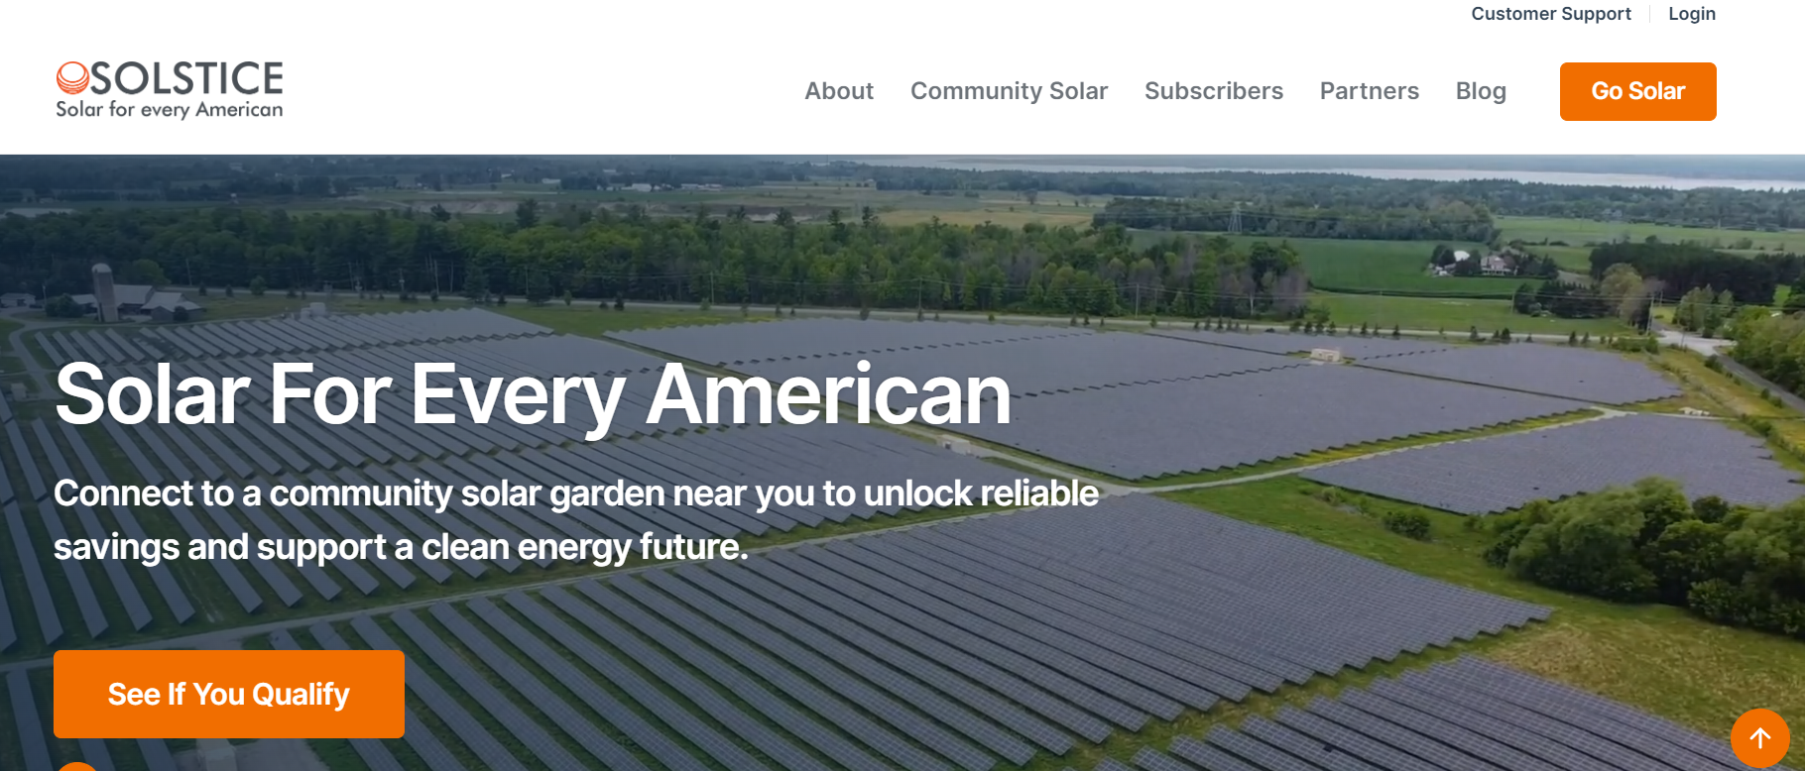
Example Website for Signing Up
Website address: www.solstice.us.

Slide 9
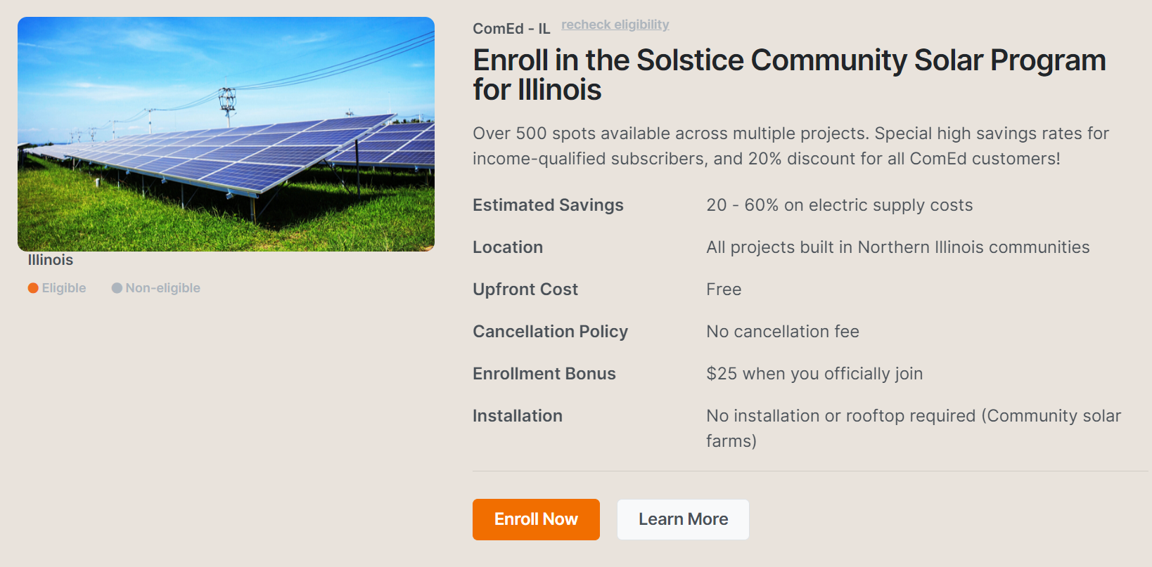
Solstice Community Solar

Slide 10
Solstice Subsctiption Process
Subscription Signup Steps – Online
1. Overview of the Enrollment Flow
A. You can sign up online in about 10 minutes
B. It is a 4-6 step process, depending on what farms you are eligible for.
C. You will need your utility bill (and a method of payment if dual bill) handy to complete the process.
D. You will also need to provide an email address to enroll.
Start Enrollment
Service Address Step
  A. Our system is determining which farms we have in your area with space available.
  Utility Connection
  A. We are pulling your usage information to determine the number of solar credits you will need to cover your bill.

Slide 11
Solstice Subsctiption Process
5. LMI Eligibility
A. Some solar farms have restrictions around income levels. We will use your documentation to confirm your eligibility for the solar farm, and if you are eligible, you will get our highest discount rate available.
Payment Method (dual bill only)
  A. We ask for a payment method on file so we are able to charge for solar credits. Solstice will cover any additional credit card surcharge for customers.
  B. You will see credits on your utility bill and receive a Solstice invoice at least 3 days before your payment method is charged.
  C. You will still be spending less, in total, than you would without community solar.

Slide 12
Solstice Subsctiption Process
7. Written Contract
A. You will have to sign both a community solar agreement with Solstice and a disclosure form for the state program. These documents confirm your participation in the program and the size of your allocation on the solar farm (how much credit you are receiving.)
B. If you are moving or need to cancel your subscription for any reason there is no fee at all.
C. We ask for 90 days notice of cancellation so that the utility can process the cancellation and confirm that you are off the project and will stop receiving credits. Subscribers will continue to be charged for solar credits until the cancellation process is complete.
  D. You will receive a copy of all the documents in your email after signing them online.

Slide 13





Contact Us
Trajectory Energy Partners
info@trajectoryenergy.com
trajectoryenergy.com
/TrajectoryEnergyPartners
/TEnergyPartners
/trajectory-energy-partners
Hal Sprague
Community Engagement Manager
hal@trajectoryenergy.com
847-204-4170
/trajectoryenergypartners

