Slide 1
Community Solar
In Rockford
July 2024

Slide 2
MEET THE TRAJECTORY TEAM
Trajectory Energy Partners brings communities, organizations, and landowners together to develop quality solar projects that contribute to local economic growth and a sustainable energy future.
We have a deep background in solar development, financing, policy, and community engagement, making us a strong partner for the communities we work with.
40 TEAM MEMBERS WORKING ACROSS THE MIDWEST AND MID-ATLANTIC
Proprietary and Confidential
2

Slide 3
ILLINOIS RENEWABLE ENERGY LAWS
Over the past two decades, the Illinois General Assembly has passed several laws to encourage and support renewable energy.
These laws bring the benefits of a clean energy economy to residents and businesses across Illinois and are expanding access to the savings, clean energy, and job benefits of solar power. Types of solar supported by these laws include:
Behind the Meter
A home, business, or organization can install solar on their roof or on their land to directly power their home or building.
Community Solar
Provides savings for electricity users that can’t install solar on their roofs by subscribing to a community solar project.
Utility-Scale Solar
Large solar systems covering hundreds of acres of land that are directly connected to higher-voltage utility lines and typically serve a single customer.
5

Slide 4
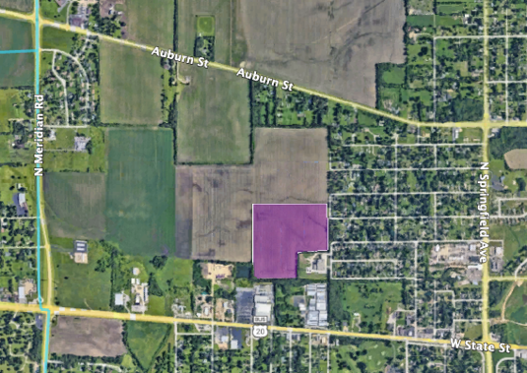
Example Project - Rock Cut Solar
Trajectory has developed a 4MWac Community Solar project on 35 acres on the western edge of the City of Rockford.
Rock Cut Solar will produce enough energy to power 600-800 homes and will bring over $100,000 in utility bill savings annually to subscribers to the project.
4

Slide 5
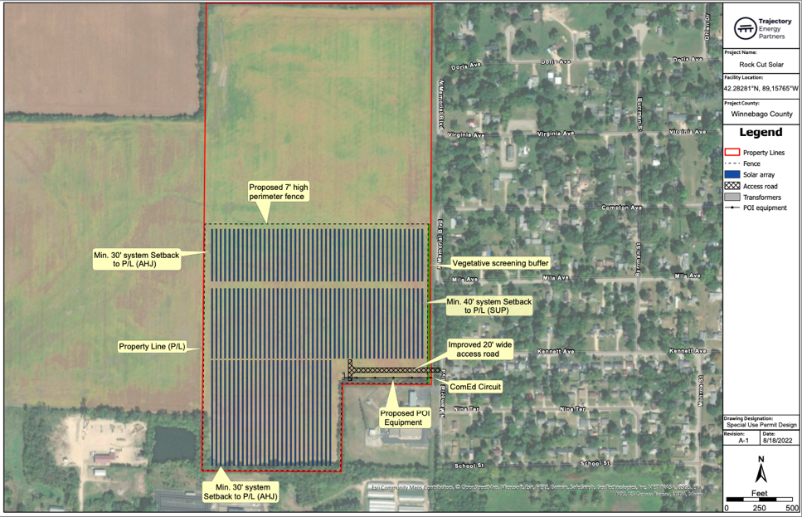
Rock Cut Solar
5

Slide 6
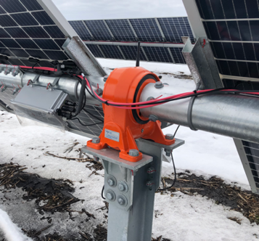
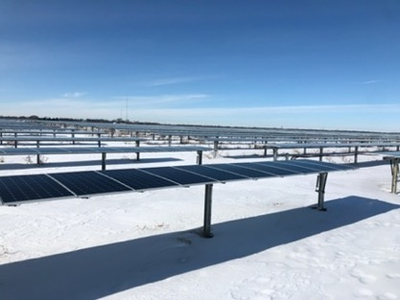
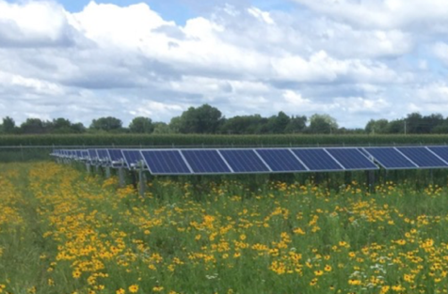
Ground Mounted Solar Systems
Ground mounted solar projects often utilize a single-axis tracker system where the solar panels are placed on a bar that rotates so the panels follow the arc the sun takes throughout the day, producing more energy than stationary panels.
Single-axis tracker system in winter in Illinois.
Example of single-axis tracker system in summer.
6

Slide 7
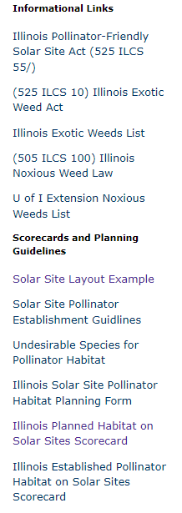
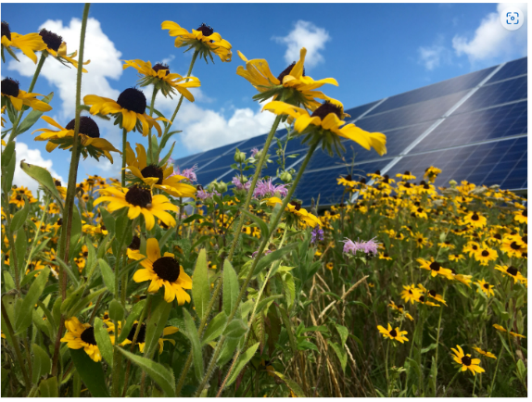
Pollinator Friendly Ground Cover
Solar Site Pollinator Scorecard - Pollinator Score Card (illinois.gov)
7

Slide 8
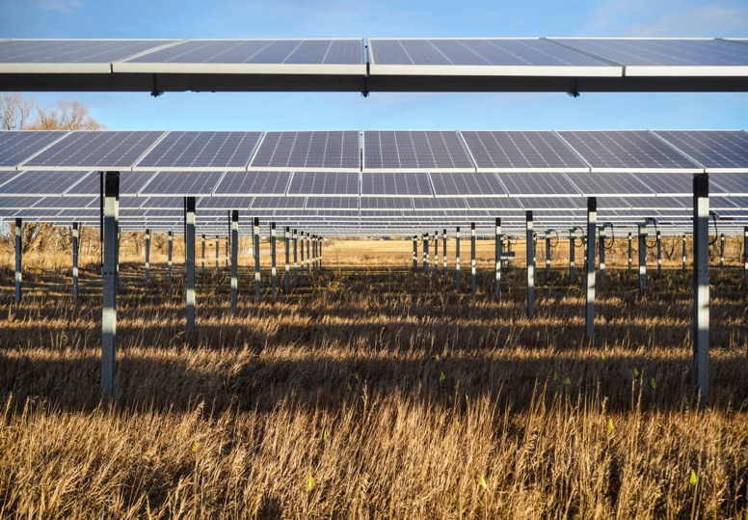
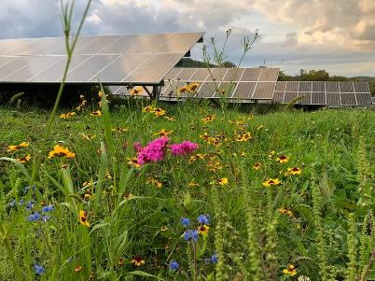
DUAL USE
Campion Solar, in Will County, will utilize its location for two purposes: renewable energy and agriculture.
Where feasible, a combination of native tallgrass and flowering plants will be planted to provide a pollinator ground cover as a habitat and food for birds, bees, butterflies and other beneficial insects, as well as hay which can be harvested to support local agricultural production as bedding and ground cover.
Local contractors will be hired, where feasible, to help with maintenance, mowing, and bailing.
16
Proprietary and Confidential
13

Slide 9
Rock Cut Solar Benefits
Property Taxes
Under Illinois law, community solar projects are assessed for tax purposes at the same rate as utility scale wind projects, providing significant property tax revenue to local taxing bodies.
Current Taxes paid at Agricultural Rate: $1,994
Estimated Year 1 Property Taxes from Solar: $32,000
35 Year total Property Taxes from Solar: $683,000
Development without demands = “free money”
Economic Development and Jobs
Rock Cut Solar will require a total investment of over $10 Million with an estimated 60% of the investment for labor; it is expected to provide 30-40 person years of construction employment.
Trajectory will work with the local building trades to ensure the project is built by local union labor. Through the many training programs under CEJA, the project will also help train new workers in the solar industry.
9

Slide 10
Other Community Benefits
Community Benefit Payment
Because Rock Cut is in the Community-Driven Community Solar Program, Trajectory Energy Partners took the additional step of partnering with Rockford Area Habitat for Humanity on its application to the Illinois Power Agency.
As part of the community benefits for the project, upon completion of the project Trajectory will make a significant donation to Rockford Area Habitat for Humanity. This will result in more affordable houses, more jobs, more youth training in construction.
Utility Bill Savings for Residents
Rock Cut Solar will produce an estimated 9,150,000 kWhs each year and provide over $100,000 annually in utility bill savings to residents, public sector entities, and other organizations in Winnebago County.
Trajectory will work with local organizations in Rockford and Winnebago County to educate residents and other organizations on the opportunity from a community solar subscription to Rock Cut Solar.
10

Slide 11
Summary
Benefits to Community:
Clean and Renewable Energy
Jobs and job training
Grid Stability
Utility savings for residents who subscribe – no cost to subscribe
Significant Property Tax Increase – 16x increase, which leads to:
Increased funding to schools, likely to lead to better schools, which lifts property values for all residents of those districts
Community benefit payment to Rockford Area Habitat for Humanity
Property Rights - Allows landowners to make the most of their property
11

Slide 12
ENERGY PRODUCTION ON AG LAND
Vehicle Miles per Acre Analysis
Land Use: Corn for ethanol production Bushels per acre: 250 Gallons Ethanol produced per acre: 675 gallons (2.7 gallon / bushel) Miles per gallon for 2021 Ford F-150: 26 miles/gallon Vehicle miles travelled per acre: 17,550 miles | Land Use: Ground Mounted Solar kWp per acre: 180kWp Solar production: 1500kWh/kWp Solar production per acre: 270,000 kWhs Miles/kWh for Ford F-150 Lightning: 2 miles/kWh Vehicle miles travelled per acre: 540,000 miles
A Hyundai Ionic goes 3.4 miles per kwh
or 918,000 miles per acre of panels
10
Proprietary and Confidential

Slide 13
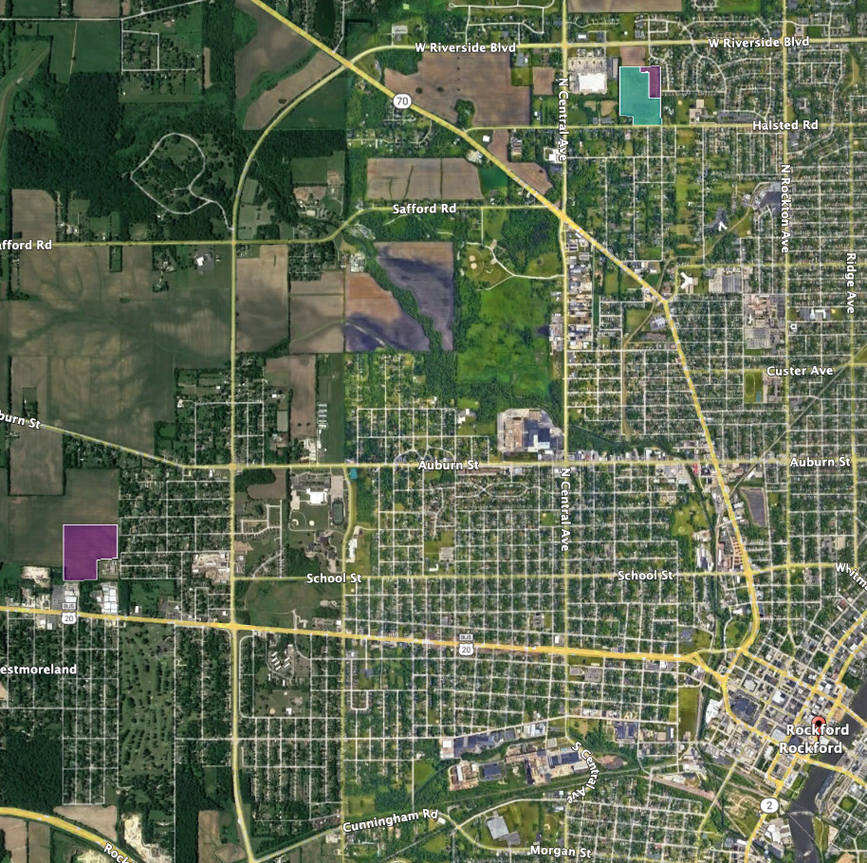
Trajectory Energy in Rockford
Rock Valley Solar
4MWac
IL Solar for All Community Solar
Approved
Rockford Solar
2MWac
IL Solar for All Community Solar
Operating
Image | Fresh Energy
Rock Cut Solar
4MWac
Community Driven Community Solar
In Development
Rock River Solar
420kWac
IL Solar for All Behind the Meter
In Construction
Image | Rob Davis

