Slide 1
Value for Solar Homes
Rockford Solar Conference
July 2024

Slide 4
Value for High-Performing Homes
Real estate education
REALTOR association engagement
Research

Slide 5
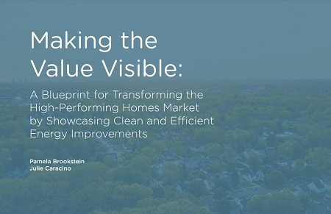
Value for High-Performing Homes

Slide 6
How do we get to consistent value for residential solar?
With narrative
With data
With education

Slide 7
The Narrative

Slide 8
The Narrative: telling the story
“We are trying to paint a picture for the buyer about why they want to come in to see this home.”​

Slide 9
Only Part of the Story
This is it! This is your home.
Situated on a quiet street in that magic zip code of 85254.
Spectacular kitchen, with wet bar and wine fridge.
Enjoy the spacious entertainers back yard, with fire pit.
Swim in the large sparkling pool.
Close to wonderful dining and shopping.
See documents tab for Solar details.

Slide 10
Only Part of the Story
This perfect residence offers panoramic views of Camelback Mountain.
Harmonious ambiance is achieved w/ Soaring Windows, Vaulted Ceilings and an abundance of Natural Light.
Serene and Tranquil backyard oasis.
The patio features herringbone laid brick which opens to an extended yard that highlights a peaceful fountain.
Solar Panels on the home are owned and reduce bills.

Slide 11
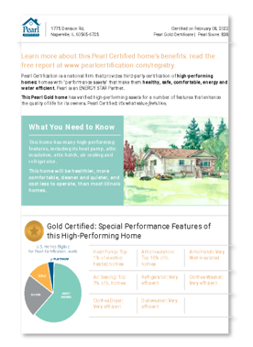
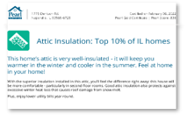
How can we help tell the story?
Turn-key (liability reduced) marketing materials
Example: Pearl Certification

Slide 12
The Data

Slide 13
Finding the Contributory Value of a System
Income approach to appraising
Value a property by income that it can generate​
PV systems generate income by producing electricity​​

Slide 14
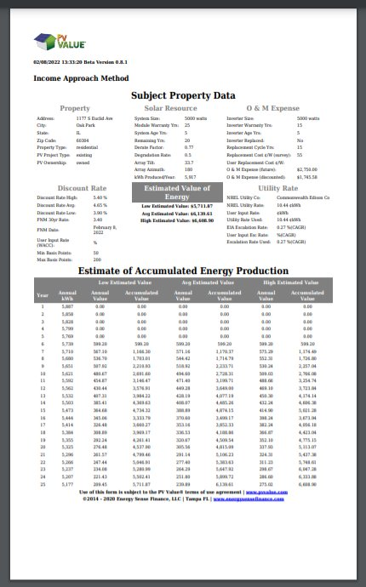
PV Value®
Free
Developed with funds from U.S. Department of Energy
Endorsed by the Appraisal Institute
PVValue.com
Notes:
CREATE A DEFENDABLE VALUE for the system

Slide 15
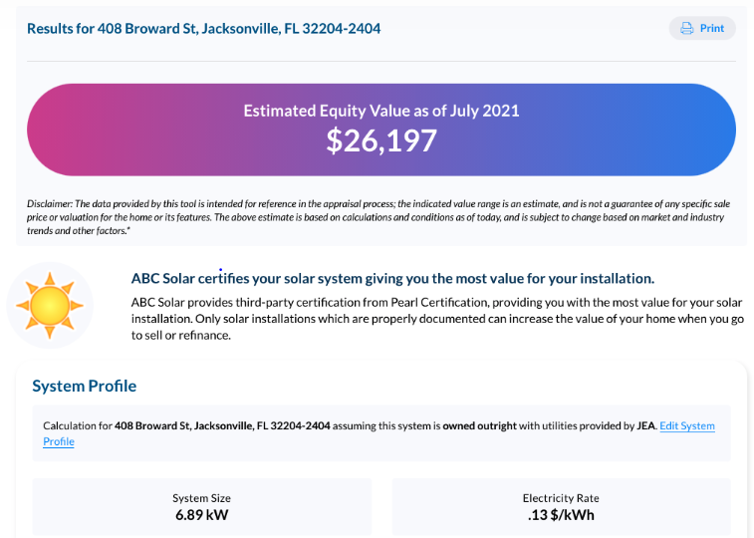
Pearl Solar Equity Calculator
Endorsed by the Appraisal Institute
Third-party certified
NREL software to calculate solar production numbers

Slide 16
Education

Slide 17
The Misunderstanding
Direct Ownership
Third-Party Ownership
Notes:
Two main ways to finance a system: Direct (which means the homeowner pays for owns the system) and Third Party Ownership (where the homeowner leases the system)

Slide 18
Thank you!
Pamela Brookstein
Pamela.Brookstein@ElevateNP.org
elevatenp.org/real-estate-professionals

